Slide 1
Chapter 18
Testing Techniques/Methods

Slide 2
Testability
Operability—it operates cleanly
Observability—the results of each test case are readily observed
Controllability—the degree to which testing can be automated and optimized
Decomposability—testing can be targeted
Simplicity—reduce complex architecture and logic to simplify tests
Stability—few changes are requested during testing
Understandability—of the design
These slides are designed to accompany Software Engineering: A Practitioner’s Approach, 7/e (McGraw-Hill 2009). Slides copyright 2009 by Roger Pressman.

Slide 3
What is a “Good” Test?
A good test has a high probability of finding an error
A good test is not redundant.
A good test should be “best of breed”
A good test should be neither too simple nor too complex
These slides are designed to accompany Software Engineering: A Practitioner’s Approach, 7/e (McGraw-Hill 2009). Slides copyright 2009 by Roger Pressman.

Slide 4
Internal and External Views
Any engineered product (and most other things) can be tested in one of two ways:
  Knowing the specified function that a product has been designed to perform, tests can be conducted that demonstrate each function is fully operational while at the same time searching for errors in each function;
  Knowing the internal workings of a product, tests can be conducted to ensure that "all gears mesh," that is, internal operations are performed according to specifications and all internal components have been adequately exercised.
These slides are designed to accompany Software Engineering: A Practitioner’s Approach, 7/e (McGraw-Hill 2009). Slides copyright 2009 by Roger Pressman.

Slide 5
Test Case Design
"Bugs lurk in corners
and congregate at
boundaries ..."
Boris Beizer
OBJECTIVE
to uncover errors
CRITERIA
in a complete manner
CONSTRAINT
with a minimum of effort and time
These slides are designed to accompany Software Engineering: A Practitioner’s Approach, 7/e (McGraw-Hill 2009). Slides copyright 2009 by Roger Pressman.

Slide 6
Software Testing
white-box
methods
black-box
methods
Methods
Strategies
These slides are designed to accompany Software Engineering: A Practitioner’s Approach, 7/e (McGraw-Hill 2009). Slides copyright 2009 by Roger Pressman.

Slide 7

White-Box Testing
... our goal is to ensure that all
statements and conditions have
been executed at least once ...
These slides are designed to accompany Software Engineering: A Practitioner’s Approach, 7/e (McGraw-Hill 2009). Slides copyright 2009 by Roger Pressman.

Slide 8
Why Cover?
logic errors and incorrect assumptions
are inversely proportional to a path's
execution probability
we often
believe
that a path is not
likely to be executed; in fact, reality is
often counter intuitive
typographical errors are random; it's
likely that untested paths will contain
some
These slides are designed to accompany Software Engineering: A Practitioner’s Approach, 7/e (McGraw-Hill 2009). Slides copyright 2009 by Roger Pressman.

Slide 9
Basis Path Testing
First, we compute the cyclomatic
complexity:
number of simple decisions + 1
or
number of enclosed areas + 1
In this case, V(G) = 4
These slides are designed to accompany Software Engineering: A Practitioner’s Approach, 7/e (McGraw-Hill 2009). Slides copyright 2009 by Roger Pressman.

Slide 10
Cyclomatic Complexity
A number of industry studies have indicated
that the higher V(G), the higher the probability
or errors.
modules
V(G)
modules in this range are
more error prone
These slides are designed to accompany Software Engineering: A Practitioner’s Approach, 7/e (McGraw-Hill 2009). Slides copyright 2009 by Roger Pressman.

Slide 11
Basis Path Testing
1
Next, we derive the
independent paths:
2
Since V(G) = 4,
there are four paths
3
Path 1: 1,2,3,6,7,8
4
Path 2: 1,2,3,5,7,8
5
6
Path 3: 1,2,4,7,8
Path 4: 1,2,4,7,2,4,...7,8
Finally, we derive test
7
cases to exercise these
paths.
8
These slides are designed to accompany Software Engineering: A Practitioner’s Approach, 7/e (McGraw-Hill 2009). Slides copyright 2009 by Roger Pressman.

Slide 12
Basis Path Testing Notes
you don't need a flow chart,
but the picture will help when
you trace program paths
count each simple logical test,
compound tests count as 2 or
more
basis path testing should be
applied to critical modules
These slides are designed to accompany Software Engineering: A Practitioner’s Approach, 7/e (McGraw-Hill 2009). Slides copyright 2009 by Roger Pressman.

Slide 13
Deriving Test Cases
Summarizing:
  Using the design or code as a foundation, draw a corresponding flow graph.
  Determine the cyclomatic complexity of the resultant flow graph.
  Determine a basis set of linearly independent paths.
  Prepare test cases that will force execution of each path in the basis set.
These slides are designed to accompany Software Engineering: A Practitioner’s Approach, 7/e (McGraw-Hill 2009). Slides copyright 2009 by Roger Pressman.

Slide 14
Control Structure Testing
Condition testing — a test case design method that exercises the logical conditions contained in a program module
Data flow testing — selects test paths of a program according to the locations of definitions and uses of variables in the program
These slides are designed to accompany Software Engineering: A Practitioner’s Approach, 7/e (McGraw-Hill 2009). Slides copyright 2009 by Roger Pressman.

Slide 15
Data Flow Testing
The data flow testing method [Fra93] selects test paths of a program according to the locations of definitions and uses of variables in the program.
  Assume that each statement in a program is assigned a unique statement number and that each function does not modify its parameters or global variables. For a statement with S as its statement number
    DEF(S) = {X | statement S contains a definition of X}
    USE(S) = {X | statement S contains a use of X}
  A definition-use (DU) chain of variable X is of the form [X, S, S'], where S and S' are statement numbers, X is in DEF(S) and USE(S'), and the definition of X in statement S is live at statement S'
These slides are designed to accompany Software Engineering: A Practitioner’s Approach, 7/e (McGraw-Hill 2009). Slides copyright 2009 by Roger Pressman.

Slide 16
Loop Testing
Simple
loop
Nested
Loops
Concatenated
Loops
Unstructured
These slides are designed to accompany Software Engineering: A Practitioner’s Approach, 7/e (McGraw-Hill 2009). Slides copyright 2009 by Roger Pressman.
Loops

Slide 17
Loop Testing: Simple Loops
Minimum conditions—Simple Loops
1. skip the loop entirely
2. only one pass through the loop
3. two passes through the loop
4. m passes through the loop m < n
5. (n-1), n, and (n+1) passes through
the loop
where n is the maximum number
of allowable passes
These slides are designed to accompany Software Engineering: A Practitioner’s Approach, 7/e (McGraw-Hill 2009). Slides copyright 2009 by Roger Pressman.

Slide 18
Loop Testing: Nested Loops
Nested Loops
Start at the innermost loop. Set all outer loops to their
minimum iteration parameter values.
Test the min+1, typical, max-1 and max for the
innermost loop, while holding the outer loops at their
minimum values.
Move out one loop and set it up as in step 2, holding all
other loops at typical values. Continue this step until
the outermost loop has been tested.
Concatenated Loops
If the loops are independent of one another
then treat each as a simple loop
else* treat as nested loops
endif*
for example, the final loop counter value of loop 1 is
used to initialize loop 2.
These slides are designed to accompany Software Engineering: A Practitioner’s Approach, 7/e (McGraw-Hill 2009). Slides copyright 2009 by Roger Pressman.

Slide 19
Black-Box Testing
requirements
output
input
events
These slides are designed to accompany Software Engineering: A Practitioner’s Approach, 7/e (McGraw-Hill 2009). Slides copyright 2009 by Roger Pressman.

Slide 20
Black-Box Testing
How is functional validity tested?
How is system behavior and performance tested?
What classes of input will make good test cases?
Is the system particularly sensitive to certain input values?
How are the boundaries of a data class isolated?
What data rates and data volume can the system tolerate?
What effect will specific combinations of data have on system operation?
These slides are designed to accompany Software Engineering: A Practitioner’s Approach, 7/e (McGraw-Hill 2009). Slides copyright 2009 by Roger Pressman.

Slide 21
Equivalence Partitioning
In this method the input domain data is divided into different equivalence data classes.
This method is typically used to reduce the total number of test cases to a finite set of testable test cases, still covering maximum requirements.
In short it is the process of taking all possible test cases and placing them into classes. One test value is picked from each class while testing.
These slides are designed to accompany Software Engineering: A Practitioner’s Approach, 7/e (McGraw-Hill 2009). Slides copyright 2009 by Roger Pressman.

Slide 22
Equivalence Partitioning
E.g.: If you are testing for an input box accepting numbers from 1 to 1000 then there is no use in writing thousand test cases for all 1000 valid input numbers plus other test cases for invalid data.
Using equivalence partitioning method above test cases can be divided into three sets of input data called as classes. Each test case is a representative of respective class.
So in above example we can divide our test cases into three equivalence classes of some valid and invalid inputs.
These slides are designed to accompany Software Engineering: A Practitioner’s Approach, 7/e (McGraw-Hill 2009). Slides copyright 2009 by Roger Pressman.

Slide 23
Equivalence Partitioning
Test cases for input box accepting numbers between 1 and 1000 using Equivalence Partitioning:
1) One input data class with all valid inputs. Pick a single value from range 1 to 1000 as a valid test case. If you select other values between 1 and 1000 then result is going to be same. So one test case for valid input data should be sufficient.
2) Input data class with all values below lower limit. I.e. any value below 1, as a invalid input data test case.
3) Input data with any value greater than 1000 to represent third invalid input class.
These slides are designed to accompany Software Engineering: A Practitioner’s Approach, 7/e (McGraw-Hill 2009). Slides copyright 2009 by Roger Pressman.

Slide 24
Equivalence Partitioning
So using equivalence partitioning you have categorized all possible test cases into three classes. Test cases with other values from any class should give you the same result.
We have selected one representative from every input class to design our test cases. Test case values are selected in such a way that largest number of attributes of equivalence class can be exercised.
Equivalence partitioning uses fewest test cases to cover maximum requirements.
These slides are designed to accompany Software Engineering: A Practitioner’s Approach, 7/e (McGraw-Hill 2009). Slides copyright 2009 by Roger Pressman.

Slide 25
Equivalence Partitioning
user
queries
output
formats
FK
input
mouse
picks
data
prompts
These slides are designed to accompany Software Engineering: A Practitioner’s Approach, 7/e (McGraw-Hill 2009). Slides copyright 2009 by Roger Pressman.

Slide 26
Equivalence Partitioning
Range, value: 1 valid and 2 invalid Equivalent Classes (ECs) are defined.
A member of a set, boolean: 1 valid and 1 invalid ECs are defined.
These slides are designed to accompany Software Engineering: A Practitioner’s Approach, 7/e (McGraw-Hill 2009). Slides copyright 2009 by Roger Pressman.

Slide 27
Sample Equivalence Classes
Valid data
user supplied commands
responses to system prompts
file names
computational data
physical parameters
bounding values
initiation values
output data formatting
responses to error messages
graphical data (e.g., mouse picks)
Invalid data
data outside bounds of the program
physically impossible data
proper value supplied in wrong place
These slides are designed to accompany Software Engineering: A Practitioner’s Approach, 7/e (McGraw-Hill 2009). Slides copyright 2009 by Roger Pressman.

Slide 28
Boundary Value Analysis
user
queries
output
formats
FK
input
mouse
picks
data
prompts
output
domain
input domain
These slides are designed to accompany Software Engineering: A Practitioner’s Approach, 7/e (McGraw-Hill 2009). Slides copyright 2009 by Roger Pressman.

Slide 29
Boundary Value Analysis
It’s widely recognized that input values at the extreme ends of input domain cause more errors in system. More application errors occur at the boundaries of input domain. ‘Boundary value analysis’ testing technique is used to identify errors at boundaries rather than finding those exist in center of input domain.
Boundary value analysis is a next part of Equivalence partitioning for designing test cases where test cases are selected at the edges of the equivalence classes.
These slides are designed to accompany Software Engineering: A Practitioner’s Approach, 7/e (McGraw-Hill 2009). Slides copyright 2009 by Roger Pressman.

Slide 30
Boundary Value Analysis
Test cases for input box accepting numbers between 1 and 1000 using Boundary value analysis:
1) Test cases with test data exactly as the input boundaries of input domain i.e. values 1 and 1000 in our case.
2) Test data with values just below the extreme edges of input domains i.e. values 0 and 999.
3) Test data with values just above the extreme edges of input domain i.e. values 2 and 1001.
These slides are designed to accompany Software Engineering: A Practitioner’s Approach, 7/e (McGraw-Hill 2009). Slides copyright 2009 by Roger Pressman.

Slide 31
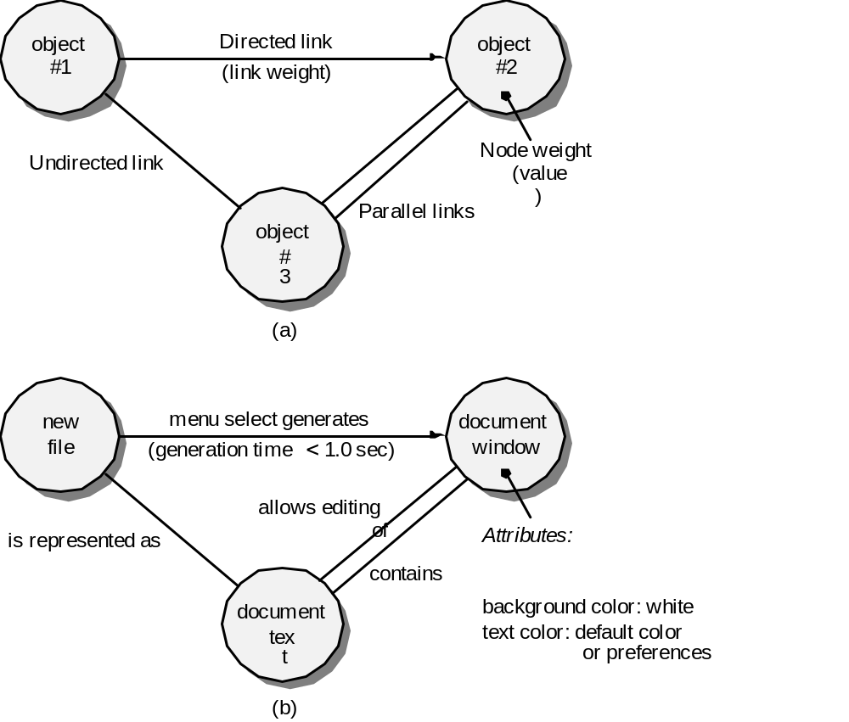
Graph-Based Methods
To understand the objects that are modeled in software and the relationships that connect these objects
In this context, we consider the term “objects” in the broadest possible context. It encompasses data objects, traditional components (modules), and object-oriented elements of computer software.

Slide 32
Graph-Based Methods
This technique of Black box testing involves a graph drawing that depicts the link between the causes (inputs) and the effects (output), which trigger the effects.
This testing utilizes different combinations of output and inputs. It is a helpful technique to understand the software’s functional performance, as it visualizes the flow of inputs and outputs in a lively fashion.
These slides are designed to accompany Software Engineering: A Practitioner’s Approach, 7/e (McGraw-Hill 2009). Slides copyright 2009 by Roger Pressman.

Slide 33
Model-Based Testing
Analyze an existing behavioral model for the software or create one.
  Recall that a behavioral model indicates how software will respond to external events or stimuli.
Traverse the behavioral model and specify the inputs that will force the software to make the transition from state to state.
  The inputs will trigger events that will cause the transition to occur.
Review the behavioral model and note the expected outputs as the software makes the transition from state to state.
Execute the test cases.
Compare actual and expected results and take corrective action as required.
These slides are designed to accompany Software Engineering: A Practitioner’s Approach, 7/e (McGraw-Hill 2009). Slides copyright 2009 by Roger Pressman.

Slide 34
Model-Based Testing
This technique usually considers the state, outputs, and inputs of a system during a specific period.
Based on the type of software that is tested, it checks for the behavioral changes of a system in a particular state or another state while maintaining the same inputs.
The test cases for this technique are created by checking the sequence of transitions and state or events among the inputs.
The whole set of test cases will have the traversal of the expected output values and all states.

Slide 35
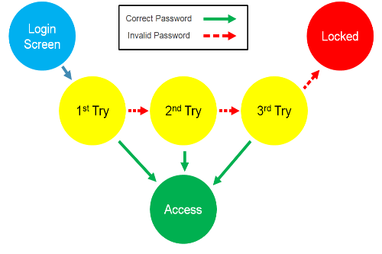
Model-Based Testing

Slide 36
Comparison Testing
Used only in situations in which the reliability of software is absolutely critical (e.g., human-rated systems)
  Separate software engineering teams develop independent versions of an application using the same specification
  Each version can be tested with the same test data to ensure that all provide identical output
  Then all versions are executed in parallel with real-time comparison of results to ensure consistency
These slides are designed to accompany Software Engineering: A Practitioner’s Approach, 7/e (McGraw-Hill 2009). Slides copyright 2009 by Roger Pressman.

